Slide 1
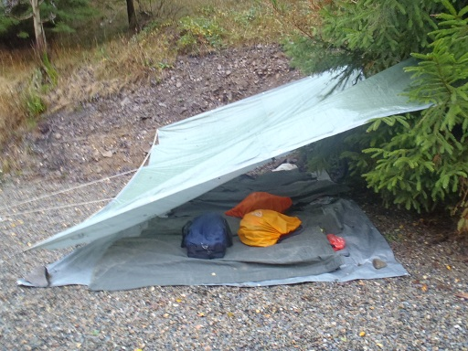
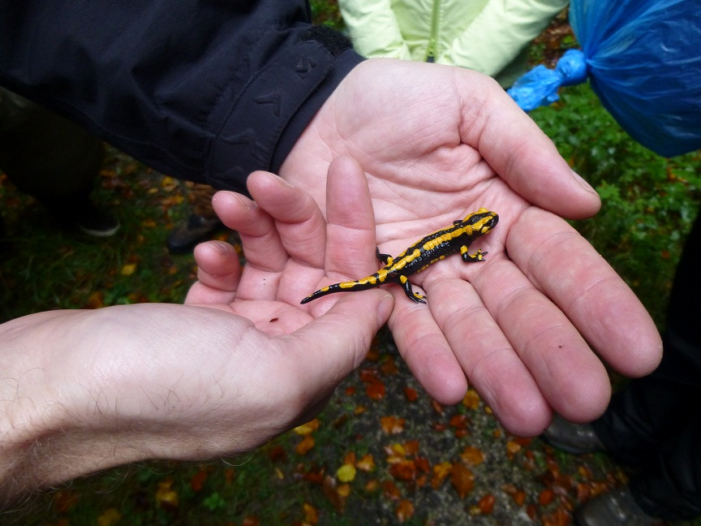
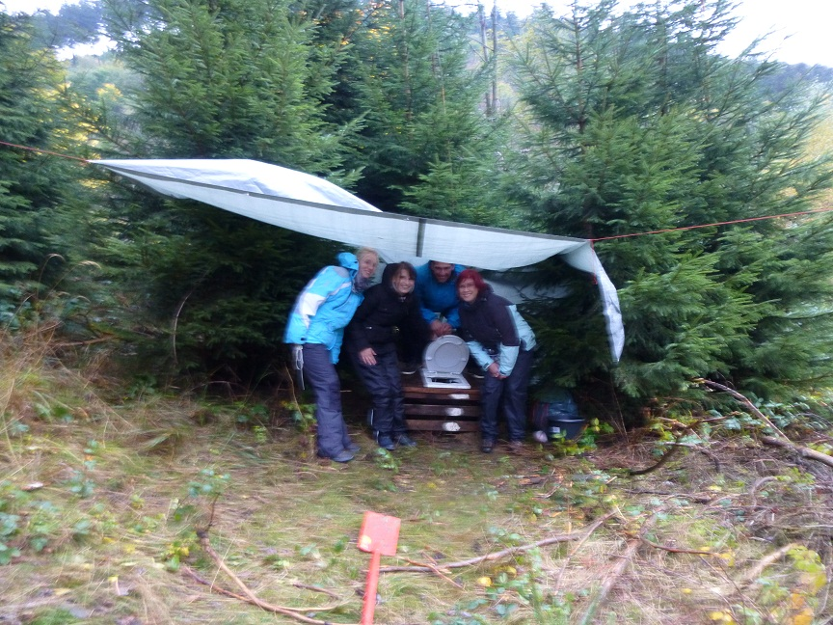
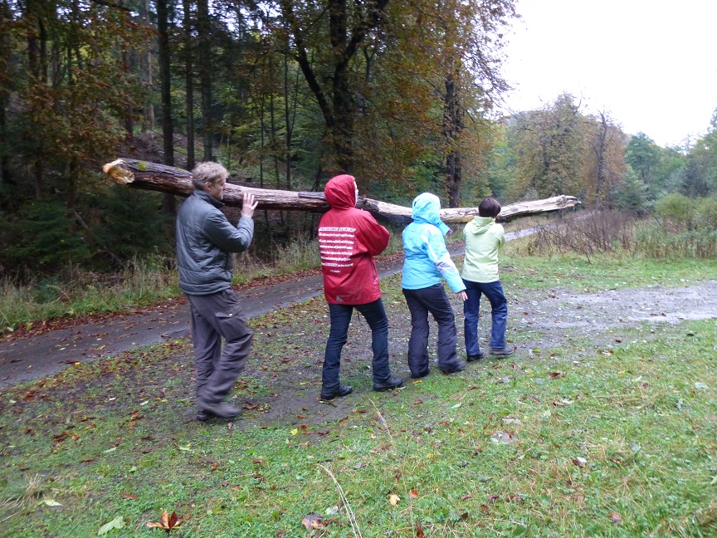
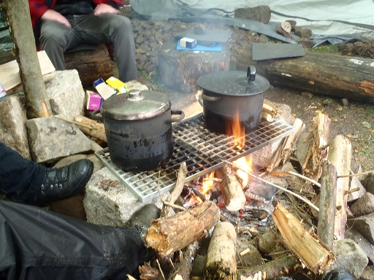
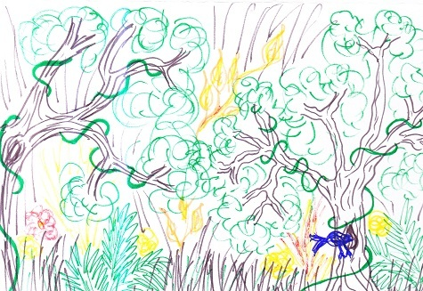
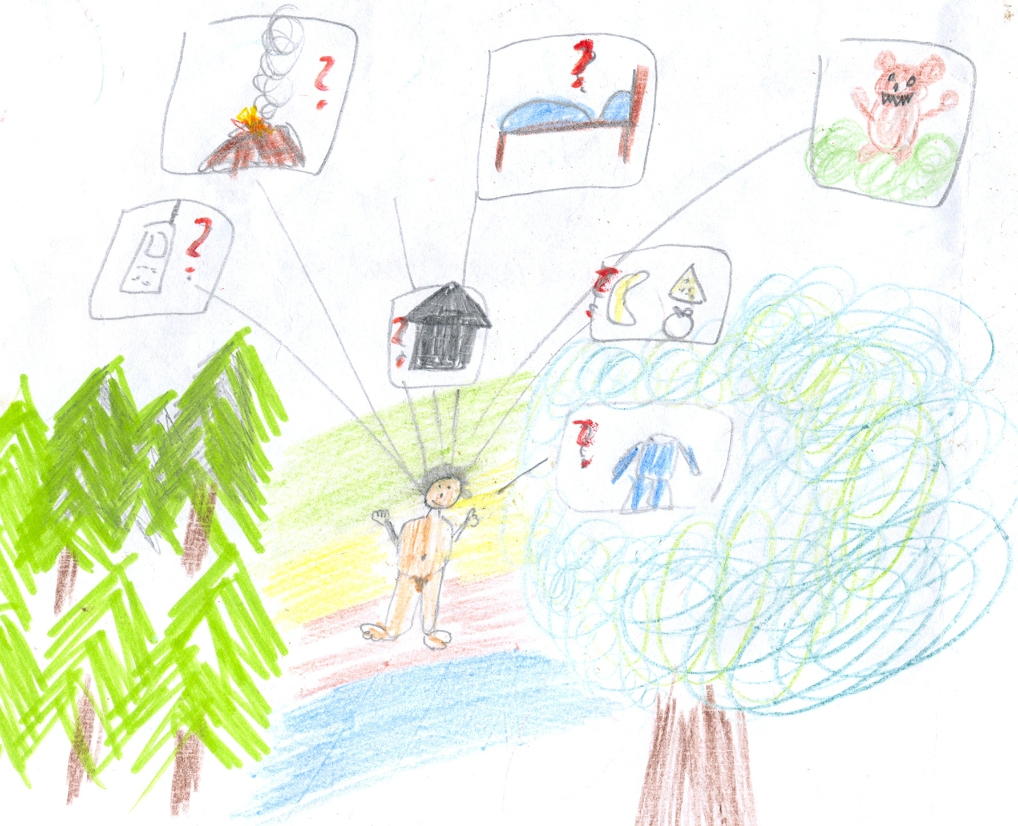
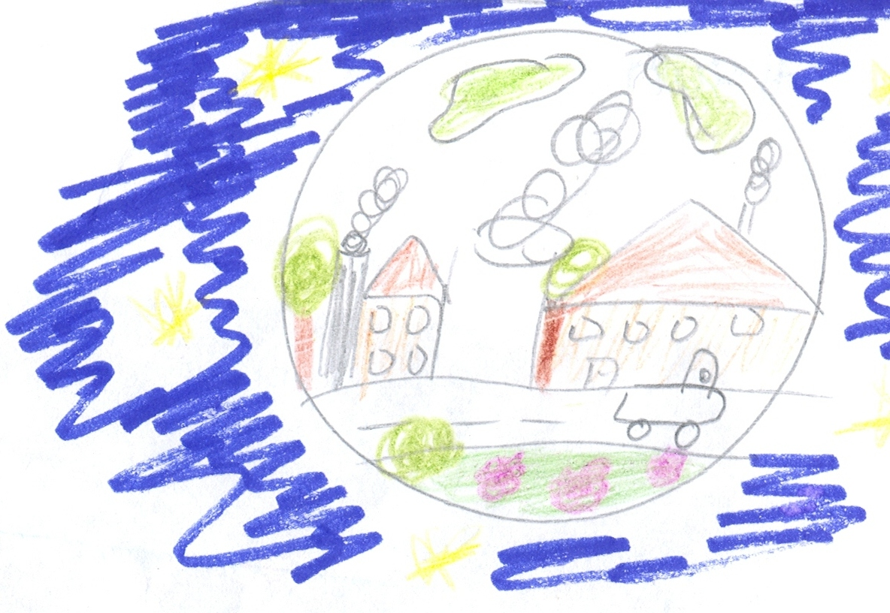
Martin Luther University
Halle-Wittenberg
Germany
Institute of Geoscience and Geography
Department of Geography Education
Von-Seckendorff-Platz 4
06120 Halle
Germany
The Power of Wilderness
Could the experience of wilderness change attitudes towards wilderness?
A Design Concept for an Advanced Training of Multiplicators for Pre-Service Teachers
of Geography and Biology in Wilderness Camps
Daniela Schmidt, Dr. Anne-Kathrin Lindau, Prof. Dr. Martin Lindner
Conference theme: preparation of teachers
Problem
Cognitive Level
- see human beings as compo-
nent of the earth´s ecosystem
- raise awareness of „Let nature
be natural“
Goals
Increasing alienation from nature (Louv 2010)
Little opportunity for authentic analysing of the importance of
natural processes in ecosystems in classroom teaching
(Miller 2009)
“Wilderness“ is negatively connotated in our society
(BUND 2002)
Emotional Level
- enable mentally and physi-cally borderline experiences
- arouse intense feelings by
natural surroundings
Project
Design a Concept for an Advanced Training of Multiplicators for Pre-Service Teachers in Wilderness Camps
Research
Cognitive level: Detection of concepts of wilderness and their conceptual change through wilderness camps
Emotional level: Detection of attitudes towards wilderness and towards sustainable lifestyle and their change through wilderness camps
Conative level: Transfer of basic concepts of wilderness education in cultivated areas
Idea
Aspects of Wilderness
- distance and contrast to civilisation
- wilderness as self-regulated process
- absence of human influence
Project „Wildnerness Gives You Strenght“
Condition for
Opportunity for organisation of wilderness
camps in the Harz National Park
Wilderness Camps:
Simple camps in an area little influenced
by agriculture and forestry
Conative Level
- create awareness for one´s own ecological and sustainable
action and take it home
- assume responsibility for nature, envorinment and
human fellows
Location of the Harz Mountains in Germany
Goals of Wilderness Education
Study Design
Nationalpark Harz in Cooperation with:
Youth Group Leaders
Social Educationalists
Child Care Worker
Pre-Service Teachers
Pretest | Wilderness Camps | Posttest
questionnaire drawings | criteria-led observation | questionnaire guideline inter- views group reflection
Example of a Wilderness Camp
Project Path
Wilderness Camp 1:
Experience of Wilderness
Photos to the Project Execution
Wilderness
Camp 1
(3 days)
Pre-Service Teachers are Participants
Main Objective: Pre-Service Teachers are Able to
Analyse the Wilderness Area.
1st day: Ask Questions about the Wilderness Area
2nd day: Analyse the Wilderness Area
Exploration of the own habitat concerning the
various questions
Use the Wilderness Area as a Field for Games
Collection of natural materials and development
of games
3rd day: Reflect Our Traces in the Wilderness
Discussion on conservation and wilderness
Wilderness
Camp 2
(5 days)
Pre-Service Teachers Evolve from Participants to Camp Leaders
Discovery in the Wilderness:
Fire Salamander
Toilet in the Wilderness
Wilderness Camp 3
(3/5 days)
+
1 Day Cultivated Area
Be a Camp Leader
+ Transfer Wilderness into Cultivated Areas
Collecting the Firewood (dead material)
Cooking Porridge in the Wilderness
Selected Results
Pretest: Detection of Concepts of Wilderness Drawings to the Question: “How do you imagine wilderness?“ | Posttest: Comments on the Change of Attitudes Towards Wilderness and Sustainable Lifestyle Through Wilderness Camps
Romanticized Image of Wilderness without Human Being
Wilderness is an area of diversity in flora and fauna Everything grows wild Area is undisturbed by human beings Process of growth and decay
No Change of Attitudes | Positive Reinforcement of Attitudes | Change of Attitudes
Towards Wilderness
I will never be a wilderness type. | I´ve noticed how much I love nature. |  | Even small things can create wilderness.
There´s nothing going on in me, when I speak with a tree. | Wilderness is the contrast to the civilized world. |  | Wilderness is important, also for our next generations to have the possibility to experience wilderness in the context of sustainability. Now I have still a bit of hope.
I don´t see myself as a part of wilderness, because I don´t deal with it in the city. | We live on nature. If we take from it, then we have to give something back. We can do it, if we protect nature.
Of course three days in a wilderness camp are too short to develop a concept of wilderness. | Wilderness has allowed me to understand existance. |  | Wilderness is important to preserve biodiversity.
Towards a Sustainable Lifestyle
I had already knew before joining the camp how to live a sustainable life to protect wilderness or nature. | The reasons for my sustainable actions in everyday life have proved. | From being at the camp I have realized, that it`s possible to abstain from particular luxury. Life goes on anyway.
Pre-Service Teacher, Female,
25 Years Old
Wilderness and Human Being in Harmony
Human being lives in the wilderness Habitat is just used for basic needs (no luxury) I am a part of nature Human beings do not disturb nature
Pre-Service Teacher, Female,
29 Years Old
Contact:
Daniela Schmidt: daniela.schmidt@geo.uni-halle.de
Dr. Anne-Kathrin Lindau: anne.lindau@geo.uni-halle.de
Prof. Dr. Martin Lindner: martin.lindner@biodidatik.uni.halle.de
References:
Louv, R. (2010): Last Child in the woods – Saving our children from Nature-Deficit-Disorder. Atlantic Books.
Miller, L. et al. (2009): Young Children Learn Though Authentic Play in a nature Explore Classroom.
(Online: http://www.dimensionsfoundation.org/research/authenticplay.pdf)
BUND 2002: Wildnisbildung. [wilderness education] (Online: www.gfn-harz.de/sites/wildnisbildung.pdf)

